Slide 1



An Introduction to Machine Learning
With Python
Terry McCann | @SQLShark

Slide 2
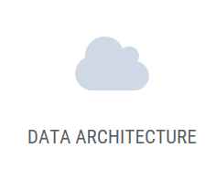


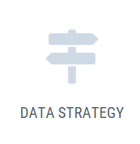
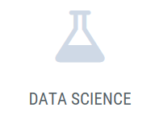
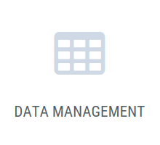
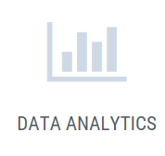
We enable our clients make sense of their data

Slide 3
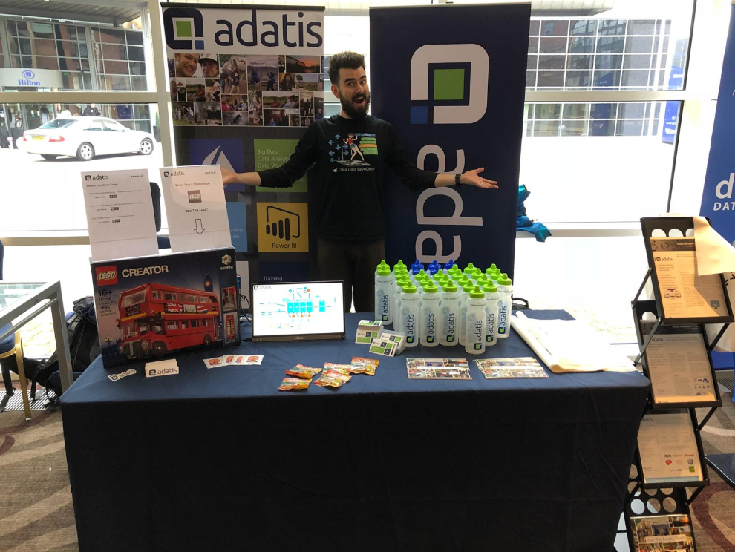

We enable our clients make sense of their data

Slide 4


Questions?
Shout them out!!

Slide 5

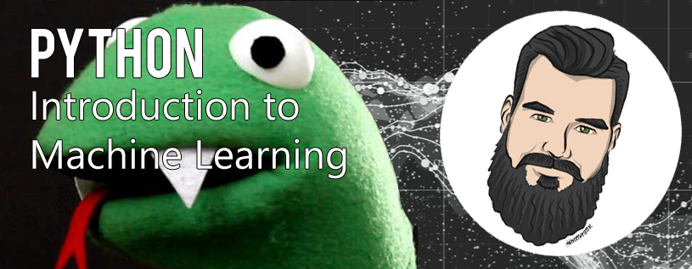
Where to find the slides and demos
https://github.com/SQLShark
Terry McCann 2018
Notes:
• How to Use the WHERE Clause
• Overview of Operators
• Filter Data by Using Comparison Operators
• Filter Data by Using String Comparisons
• Filter Data by Using Logical Operators
• Filter Data Using a Range of Values
• Filter Data Using a List of Values
• Working with NULL Values
• Introducing Native SQL Server Functions
• Functions Relating to NULL Values

Slide 6
In this session we will look to understand what is Machine learning?
We will explore the process, the use cases and how to get started.
We will understand why Python is a great Language, and how to advance your skills in machine learning
Notes:
A history of graph databases
Why they are different to Relational
Changes in SQL 2017
Use cases
Demo
Limitations & Impressions so far
** Who has used a graph database before? **

Slide 7

What is Machine Learning?
https://www.deviantart.com/cyberaeon

Slide 8
Expert systems

Slide 9
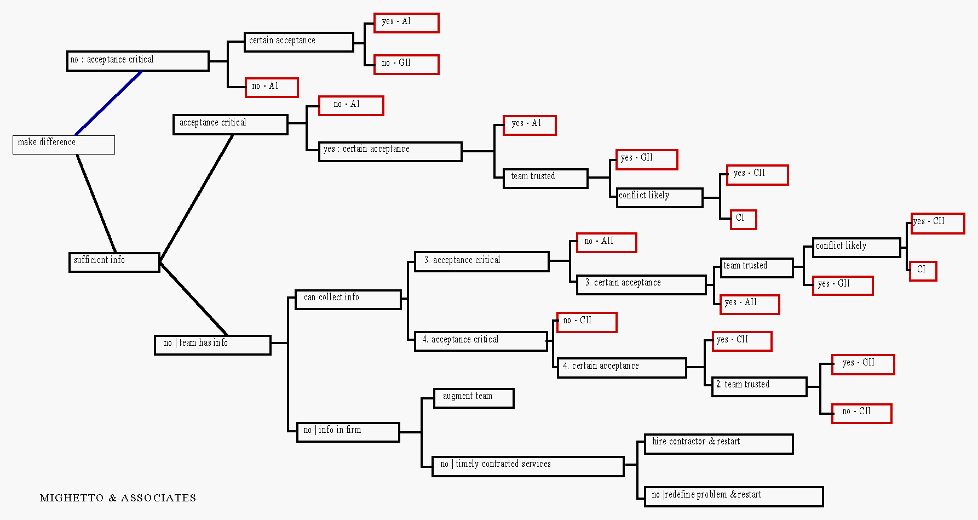
Expert systems

Slide 10
A machine is said to learn from experience E with respect to some class of tasks T and performance measure P
Its performance at tasks in T, as measured by P, improves with experience E.
https://www.quora.com/What-is-the-best-definition-for-machine-learning
Notes:
In simpler terms, Machine learning provides systems the ability to automatically learn and improve from experience without being explicitly programmed. It relies on underlying hypothesis of creating the model and tries to improve it by fitting more data into the model over time.

Slide 11
data
“Hey, I am trying to better understand my customers. I think there might be a pattern in their behaviour, but I am struggling to see it”
“Hey, I am trying to better understand my customers. I think there might be a pattern in their behaviour, but I am struggling to see it”
Clustering
High Value
Feature 2
Potential
Risk
Feature 1
Notes:
In simpler terms, Machine learning provides systems the ability to automatically learn and improve from experience without being explicitly programmed. It relies on underlying hypothesis of creating the model and tries to improve it by fitting more data into the model over time.

Slide 12
data
“Hey, I am trying to predict how much someone will spend next time they come to my store”
“Hey, I am trying to predict how much someone will spend next time they come to my store”
Regression
Feature 2
Feature 1
Notes:
In simpler terms, Machine learning provides systems the ability to automatically learn and improve from experience without being explicitly programmed. It relies on underlying hypothesis of creating the model and tries to improve it by fitting more data into the model over time.

Slide 13
data
“Hey, I am trying to predict if an insurance claim is fraudulent or not”
“Hey, I am trying to predict if an insurance claim is fraudulent or not”
Classification
Fraud
Not Fraud
Notes:
In simpler terms, Machine learning provides systems the ability to automatically learn and improve from experience without being explicitly programmed. It relies on underlying hypothesis of creating the model and tries to improve it by fitting more data into the model over time.

Slide 14
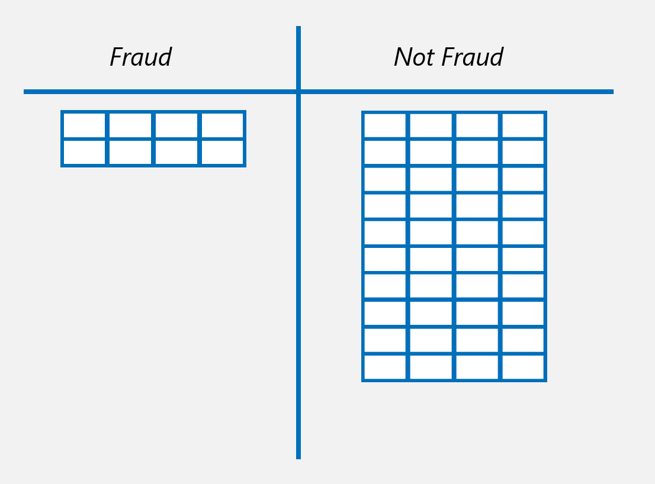
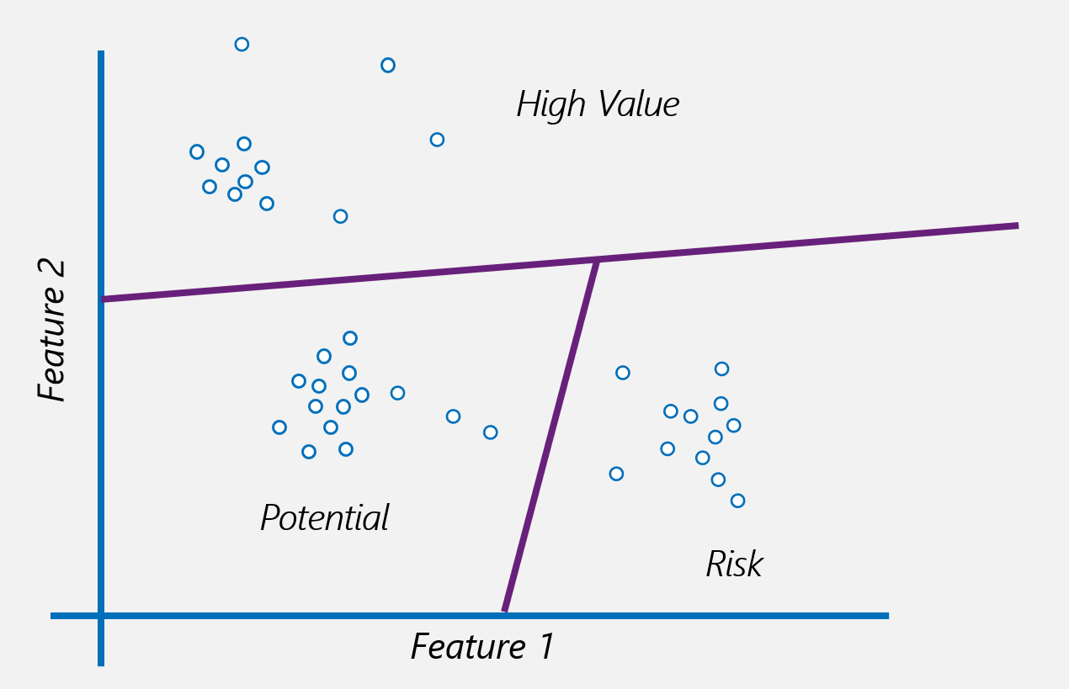
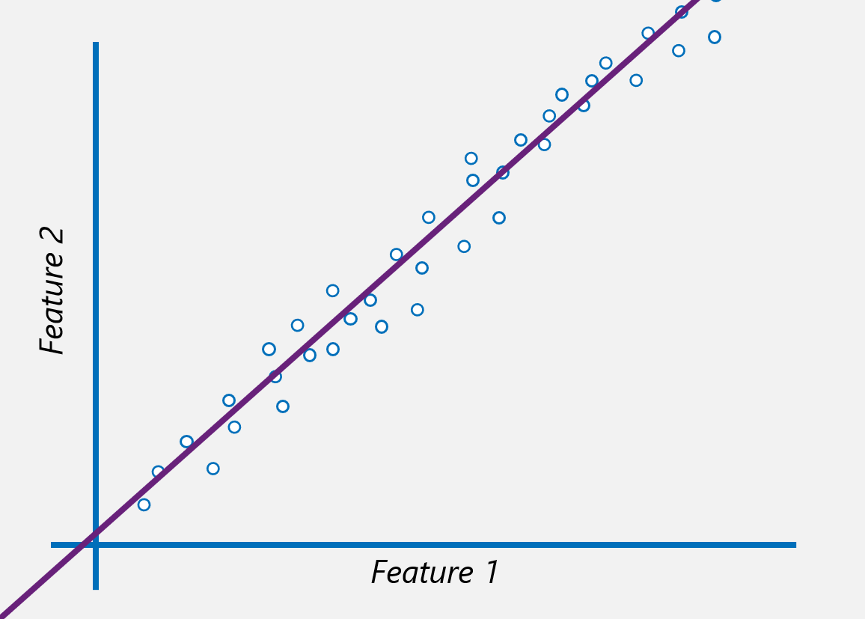

Types of machine learning
Clustering
Regression
Classification
Unsupervised
Supervised
Notes:
tokenization stemming lemmatization
Document comparison
Sentiment analysis
Classification
Named entity recognition – find additional parties involved.

Slide 15
Supervised Learning
data
Train
Test
70% Split 30%
Algorithm
Model
M
M
Validate
Notes:
tokenization stemming lemmatization
Document comparison
Sentiment analysis
Classification
Named entity recognition – find additional parties involved.

Slide 16
Supervised Learning
New data
M
Model
Prediction
Notes:
tokenization stemming lemmatization
Document comparison
Sentiment analysis
Classification
Named entity recognition – find additional parties involved.

Slide 17

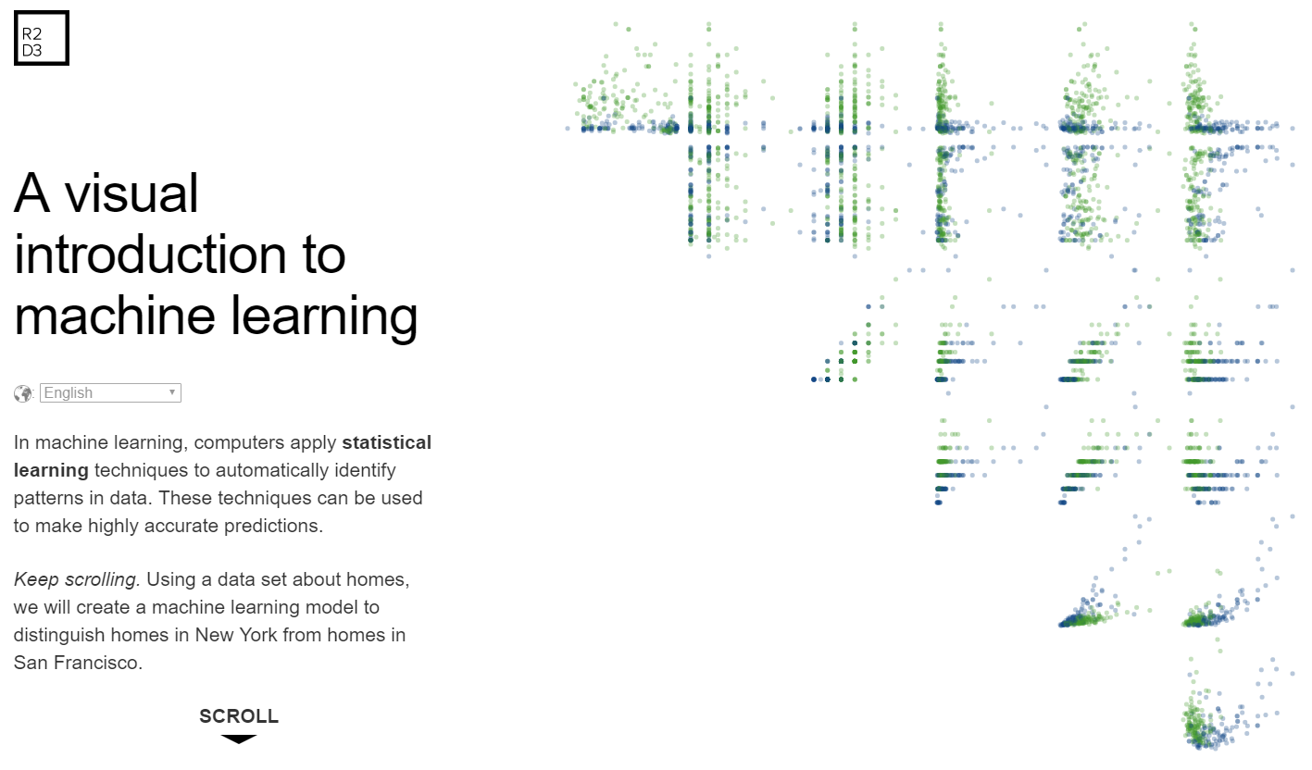
Notes:
Created in 1990 by Guido Van Rossum – He famously came up with the language when he had a week off over Christmas in 1989.
The name comes in part from Rossum’s interest in the Monty Python.

Slide 18
http://www.r2d3.us/visual-intro-to-machine-learning-part-1/
Notes:
Created in 1990 by Guido Van Rossum – He famously came up with the language when he had a week off over Christmas in 1989.
The name comes in part from Rossum’s interest in the Monty Python.

Slide 19

Python:
Fundamentals
print(“Hello, Leeds!”)
Notes:
Created in 1990 by Guido Van Rossum – He famously came up with the language when he had a week off over Christmas in 1989.
The name comes in part from Rossum’s interest in the Monty Python.

Slide 20

Beautiful is better than ugly
Explicit is better than implicit
Simple is better than complex
Complex is better than complicated
Readability counts
The Zen of Python (PEP 20)
Notes:
tokenization stemming lemmatization
Document comparison
Sentiment analysis
Classification
Named entity recognition – find additional parties involved.

Slide 21
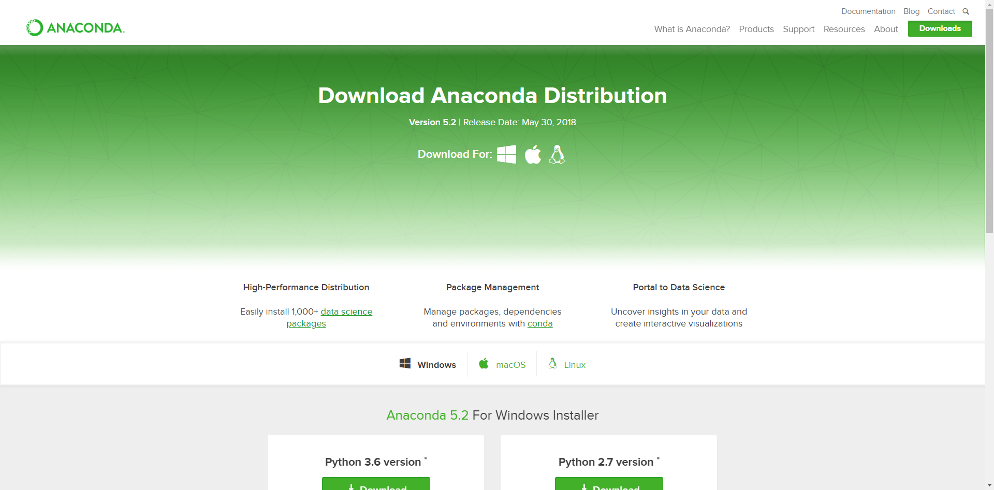
Beautiful is better than ugly
Explicit is better than implicit
Simple is better than complex
Complex is better than complicated
Readability counts
Notes:
tokenization stemming lemmatization
Document comparison
Sentiment analysis
Classification
Named entity recognition – find additional parties involved.

Slide 22
Python is…
An interpreted language
It has a base language which is extended with modules
Indents are important! Indents over curly brackets
Supports: variables, lists, dictionaries and tuples
Duck typed
Awesome!!
Notes:
def calc(a,b):
return a+b
calc(1,2) → will return 1+2 = 3
calc('hello','world') --> will return hello world
calc([1],[2]) --> will return [1,2]

Slide 23
DS/ML Modules
Numpy – Numerical Python
SciPy – Scientific Python
Pandas - Data wrangling
MatPlotLib - Data visualisation
Scikit-learn - Machine learning (shallow)
….
TensorFlow - Machine Learning (deep)
NLTK - Natural Language processing
How to add modules? PIP
Notes:
tokenization stemming lemmatization
Document comparison
Sentiment analysis
Classification
Named entity recognition – find additional parties involved.

Slide 24
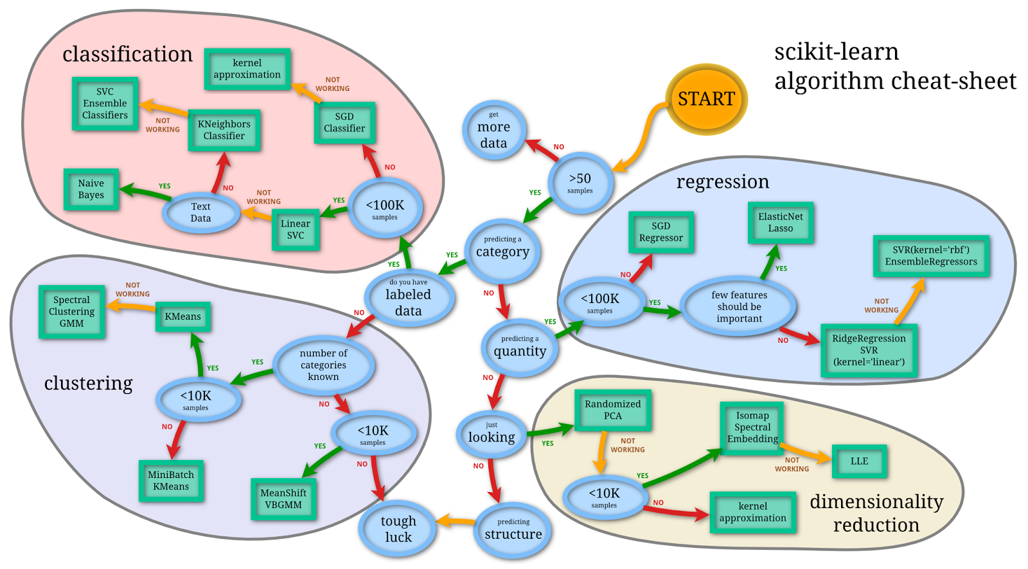
Notes:
tokenization stemming lemmatization
Document comparison
Sentiment analysis
Classification
Named entity recognition – find additional parties involved.

Slide 25
Python:
Demos
Notes:
Created in 1990 by Guido Van Rossum – He famously came up with the language when he had a week off over Christmas in 1989.
The name comes in part from Rossum’s interest in the Monty Python.

Slide 26

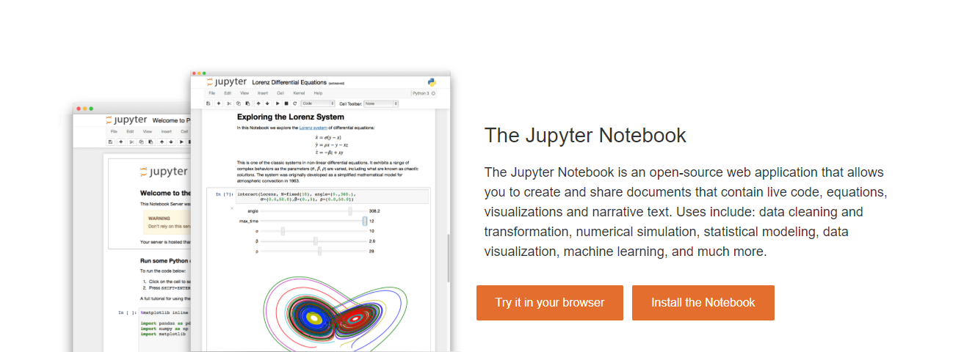

Notes:
tokenization stemming lemmatization
Document comparison
Sentiment analysis
Classification
Named entity recognition – find additional parties involved.

Slide 27
Python Fundamentals
Clustering
Regression
Classification
Notes:
tokenization stemming lemmatization
Document comparison
Sentiment analysis
Classification
Named entity recognition – find additional parties involved.

Slide 28
SQL Server 2017 ML
Notes:
tokenization stemming lemmatization
Document comparison
Sentiment analysis
Classification
Named entity recognition – find additional parties involved.

Slide 29
Traditional Analytics
Data Warehousing
Data Visualisation
Report development
SSAS / Power BI
Business Intelligence
Mathematics
Advanced Statistics
Machine Learning
Natural Language Processing
Optimisation
AI
Data Science
Model deployment
Model management
Model monitoring
Automated retraining
DataOps
Data Engineering

Slide 30
Python!
Python is amazing, so versatile.
If you are serious about Machine Learning then learn Python. Learn R too, but Python for production.
Start basic and build from there.
Thank you
@SQLShark
tpm@adatis.co.uk
www.adatis.co.uk
@AdatisBI

Slide 31
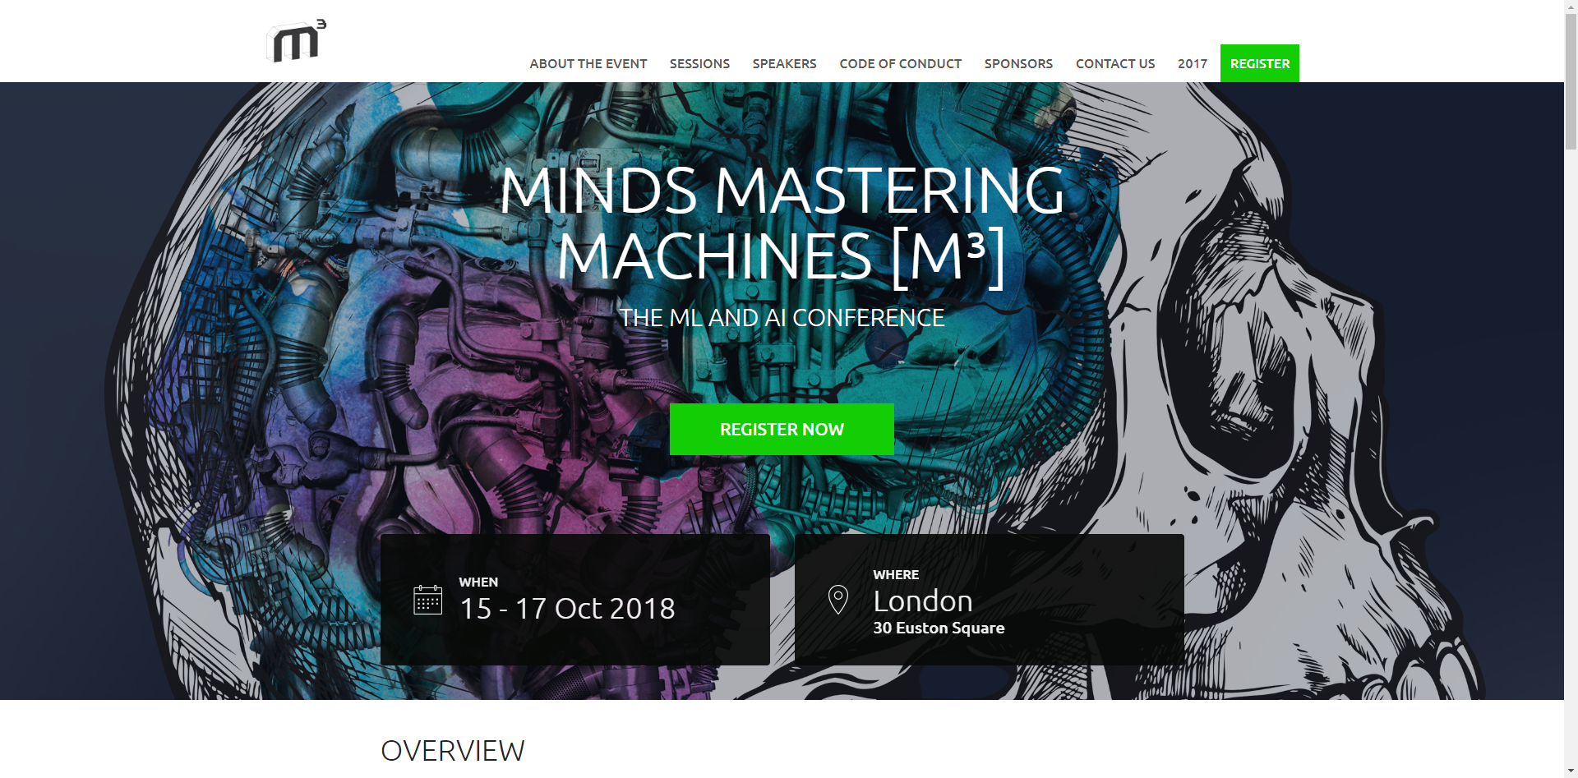
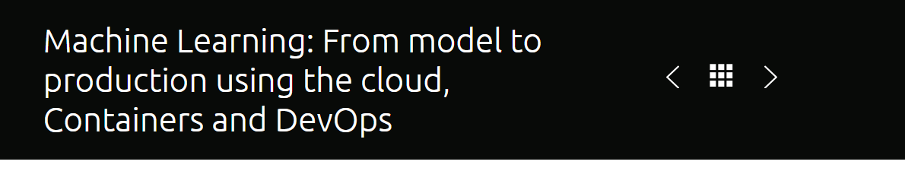
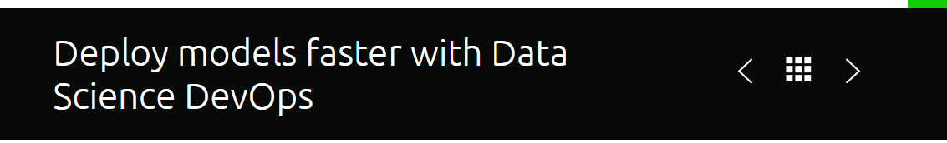
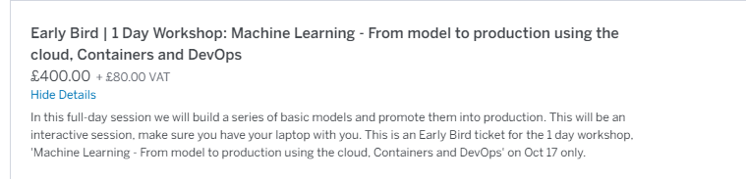
Python!
Python is amazing, so versatile.
If you are serious about Machine Learning then learn Python. Learn R too, but Python for production.
Start basic and build from there.
Thank you
@SQLShark
tpm@adatis.co.uk
www.adatis.co.uk
@AdatisBI

Slide 32
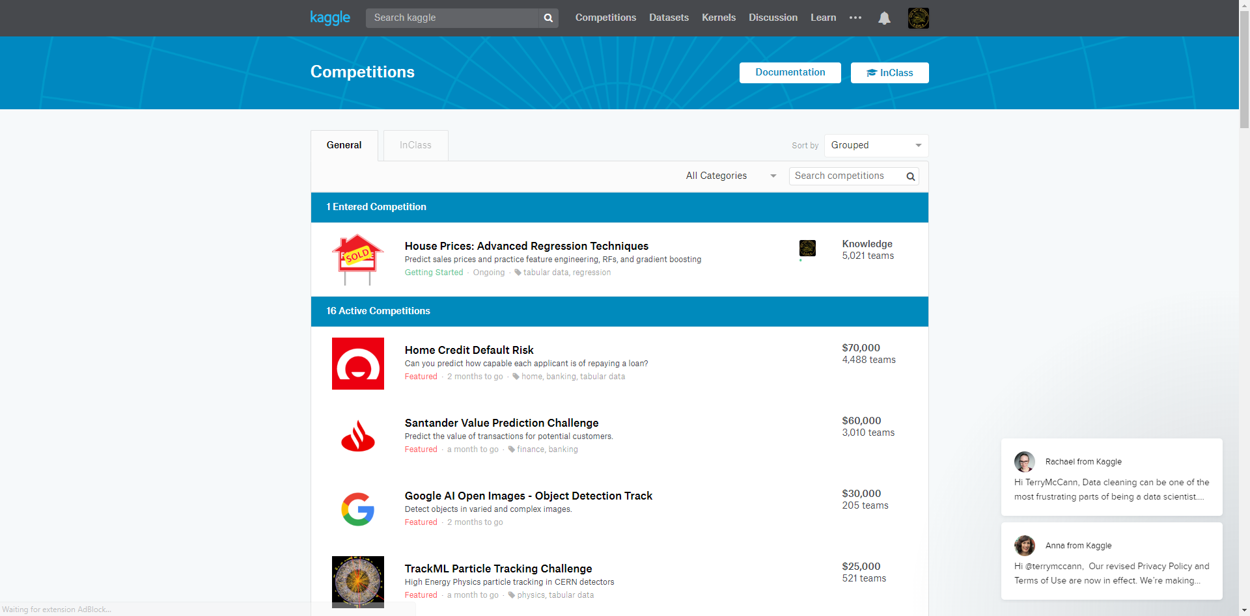
Python!
Python is amazing, so versatile.
If you are serious about Machine Learning then learn Python. Learn R too, but Python for production.
Start basic and build from there.
Thank you
@SQLShark
tpm@adatis.co.uk
www.adatis.co.uk
@AdatisBI

Slide 33
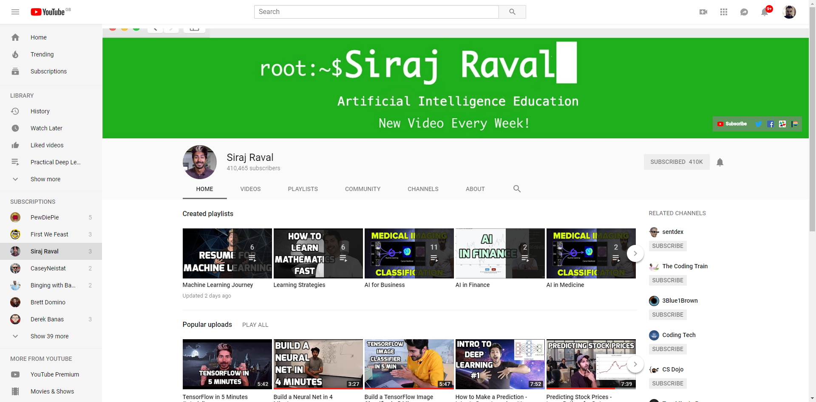
Python!
Python is amazing, so versatile.
If you are serious about Machine Learning then learn Python. Learn R too, but Python for production.
Start basic and build from there.
Thank you
@SQLShark
tpm@adatis.co.uk
www.adatis.co.uk
@AdatisBI

Slide 34
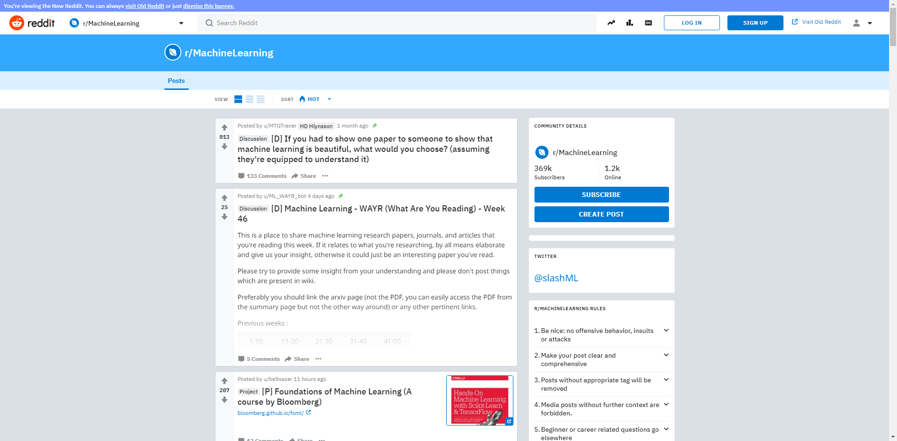
Python!
Python is amazing, so versatile.
If you are serious about Machine Learning then learn Python. Learn R too, but Python for production.
Start basic and build from there.
Thank you
@SQLShark
tpm@adatis.co.uk
www.adatis.co.uk
@AdatisBI

